Slide 1


PeakPacer
Fitness Tracker
"PeakPacer" empowers users to set and achieve personalized fitness goals, offering insights, progress tracking, and holistic wellness support. Foster consistency, celebrate achievements, and embrace a healthier lifestyle with this comprehensive fitness companion.
Notes:
<a href="https://www.freepik.com/free-photos-vectors/people">People photo created by cookie_studio - www.freepik.com</a>

Slide 2
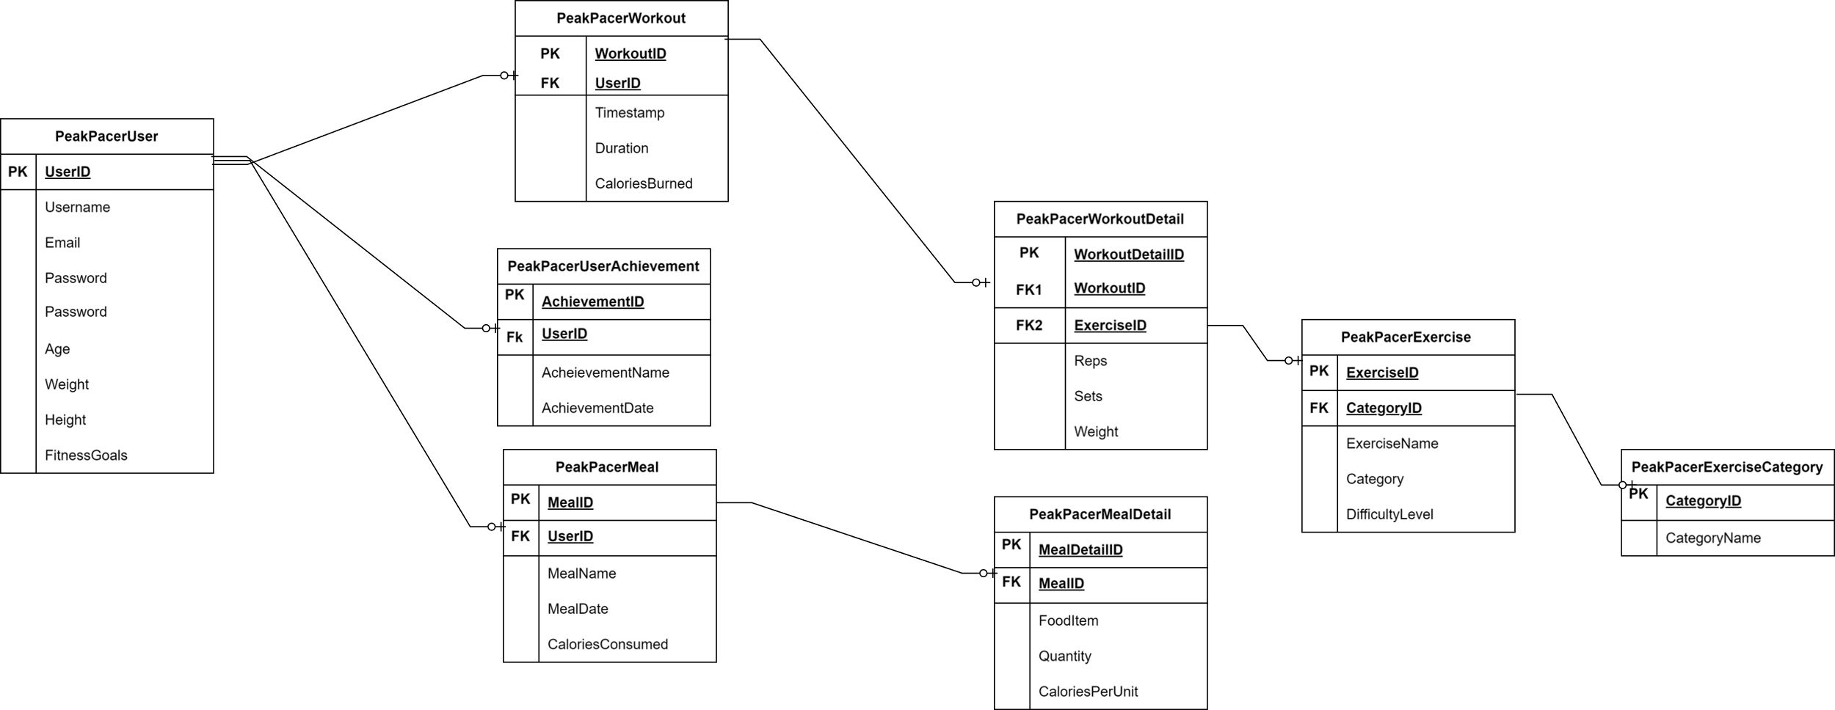
Here is a Schema For PeakPacer

Slide 3

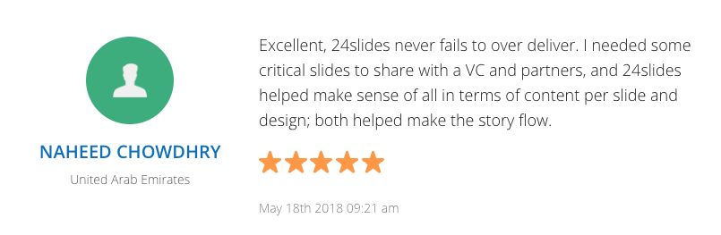

Purposes
Love the accountability features! Tracking my daily activity and workouts has become a habit, and it's paying off. The app's holistic approach sets it apart—definitely worth it!
🎯 Empowerment: Set and achieve personalized fitness goals tailored to your aspirations.
📈 Insights & Feedback: Receive detailed analyses and tailored recommendations for optimizing your workouts.
📊 Progress Visualization: Track your fitness journey visually, witnessing tangible results over time.
🤝 Accountability: Monitor daily activity and exercise habits for consistent progress and motivation.
💪 Holistic Wellness: Beyond exercise, "PeakPacer" supports overall health, stress management, and balance.
before
PeakPacer is a must-have for anyone serious about their fitness goals. The holistic support, personalized insights, and easy-to-use interface make it my top choice. 5 stars!
PeakPacer has revolutionized my fitness journey! Personalized goals, insightful feedback, and seamless progress tracking keep me motivated. A holistic approach to wellness makes it my go-to app for a healthier lifestyle. PeakPacer makes staying fit fun and achievable. The visual progress charts and tailored recommendations keep me engaged. It's not just an app; it's a wellness companion!
Go to PeakPacer.com/GetFit to find out more

Slide 4






CHALLENGES ENCOUNTERED DURING THE PROJECT
CHALLENGE
SOLUTION
During development, a critical juncture emerged necessitating the incorporation of a primary key, "Exercise Category." This classification proves essential for user-centric navigation, enabling streamlined workout routines targeting specific fitness objectives. By categorizing exercises into distinct body parts and fitness types—be it cardio, strength training, or flexibility—users can precisely tailor their goals, fostering a more personalized and effective fitness experience.
Confronted with the challenge, our team revisited the database schema. To address the need for exercise categorization, we introduced a new table, "EXERCISECATEGORY," featuring CategoryName and CategoryID as key attributes. Subsequently, CategoryID was integrated as a foreign key in the "EXERCISE" table. This enhancement ensures seamless categorization of exercises, enhancing user navigation and goal customization. The updated schema was then validated through retesting in MySQL Workbench.
As used by
Go to peakpacer.com/getfit to find out more

Slide 5
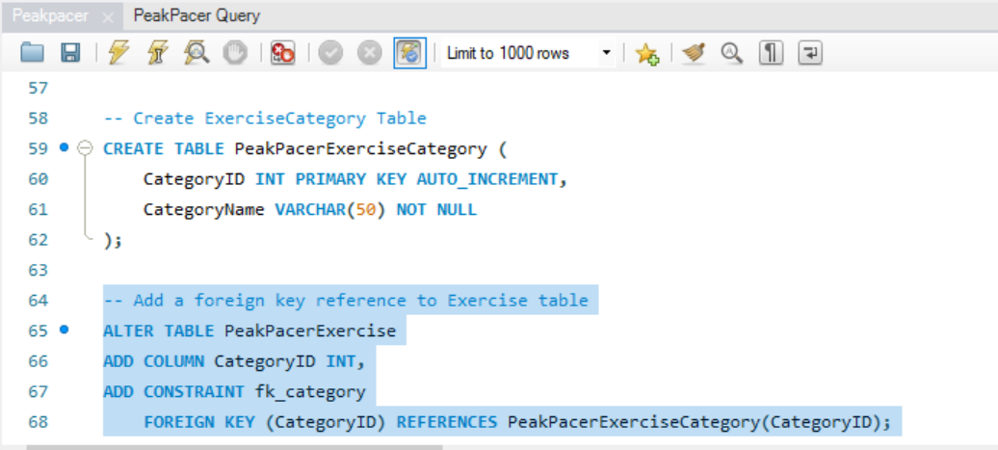
CODES FOR THE SOLUTION OF THE CHALLENGE
POSTGRESQL FORMAT
-- Create ExerciseCategory Table
CREATE TABLE PeakPacerExerciseCategory (
CategoryID SERIAL PRIMARY KEY,
CategoryName VARCHAR(50) NOT NULL
);
-- Add a foreign key reference to Exercise table
ALTER TABLE PeakPacerExercise
ADD COLUMN CategoryID INT REFERENCES PeakPacerExerciseCategory(CategoryID);
Notes:
Photo by Content Pixie on Unsplash

Slide 6



Achieving Peak Fitness: A 3-Step Guide with PeakPacer
Set Personalized Fitness Goals
Track and Monitor Daily Activity
Access Insights and Celebrate Achievements
Upon logging in, users create a profile.
Navigate to the "Goals" section to set personalized objectives.
Receive tailored recommendations
Access the intuitive dashboard.
Utilize the app to track diverse activities.
Receive real-time feedback on progress.
Explore detailed analyses and insights into performance.
Celebrate achievements as milestones are reached.
Engage with the holistic wellness features.
01
02
03
Notes:
Photo by Dane Wetton on Unsplash
Photo by Derick McKinney on Unsplash
Photo by bruce mars on Unsplash

Slide 7





FUTURE
ENHANCEMENT
Personalized Music Integration
Elevate the user experience by allowing seamless integration with personal playlists from various music apps. Empower users to exercise to their favorite tunes, enhancing motivation and enjoyment.
Interactive Virtual Assistant
Introduce an advanced virtual assistant or instructor with interactive features. Tailor encouragement and instructions based on user progress, creating a dynamic and engaging fitness environment.
Dynamic Aerobics and Dance Sets
Expand the app's appeal by incorporating diverse sets of aerobics exercises and dance routines. Make workouts not only effective but also enjoyable, catering to a broader audience with varying fitness preferences.
Visual Learning through Animated Demonstrations
Expand the app's appeal by incorporating diverse sets of aerobics exercises and dance routines. Make workouts not only effective but also enjoyable, catering to a broader audience with varying fitness preferences.
Notes:
Photo by Angelos Michalopoulos on Unsplash

Slide 8
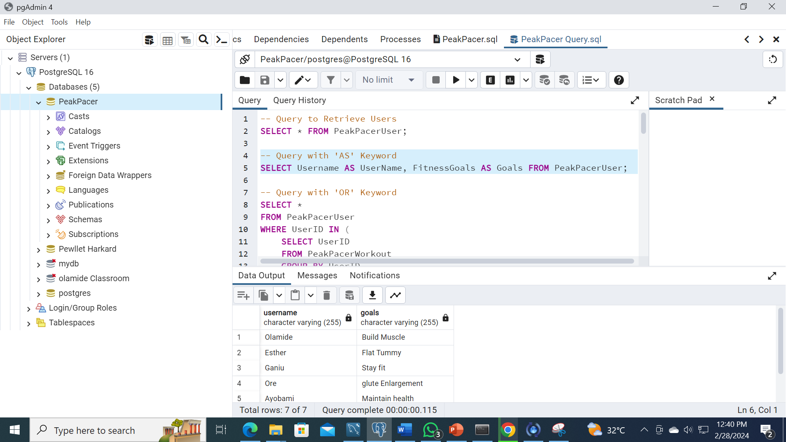
Query with ‘AS’ Keyword (pgAdmin 4)
Notes:
Photo by bruce mars on Unsplash

Slide 9
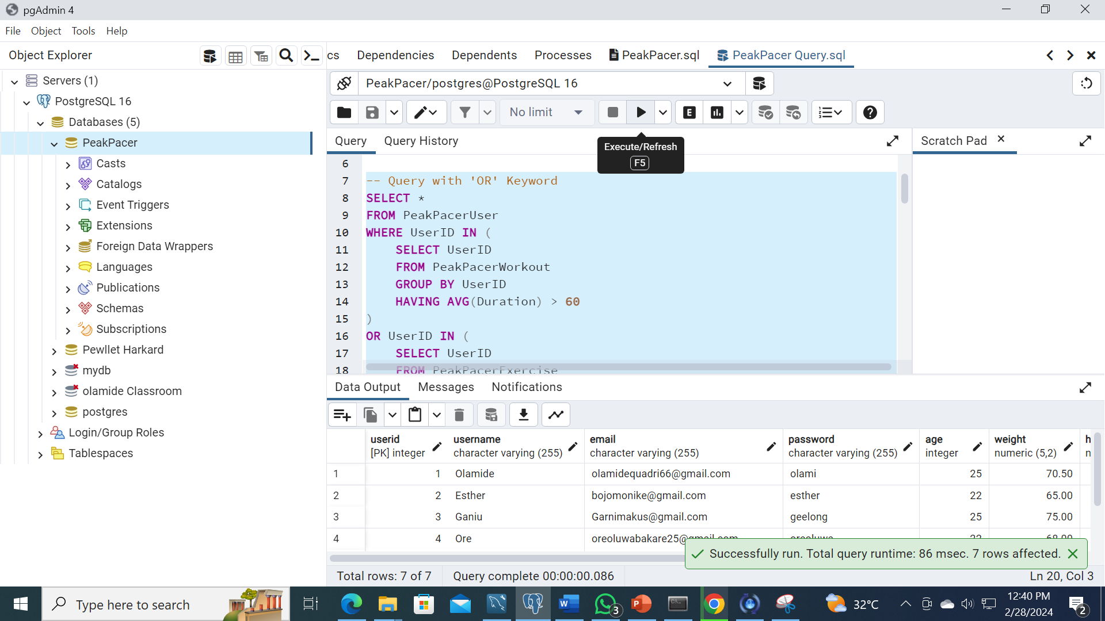
Query with ‘OR’ Keyword (pgAdmin 4)
Notes:
Photo by bruce mars on Unsplash

Slide 10

Query with ‘AND’ Keyword (pgAdmin 4)
Notes:
Photo by bruce mars on Unsplash

Slide 11
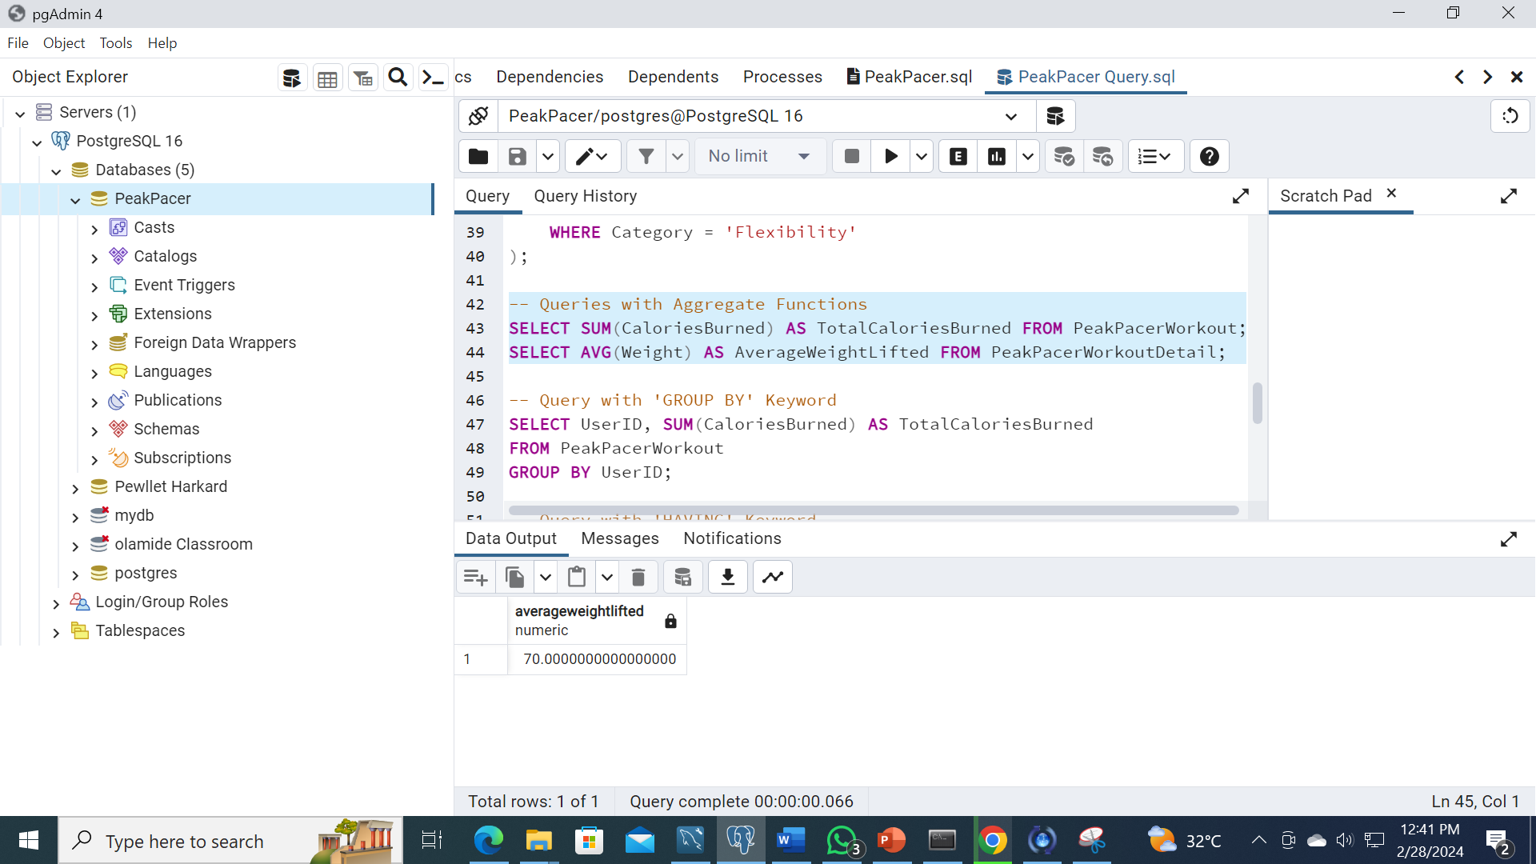
Query with Aggregate Functions (pgAdmin 4)
Notes:
Photo by bruce mars on Unsplash

Slide 12
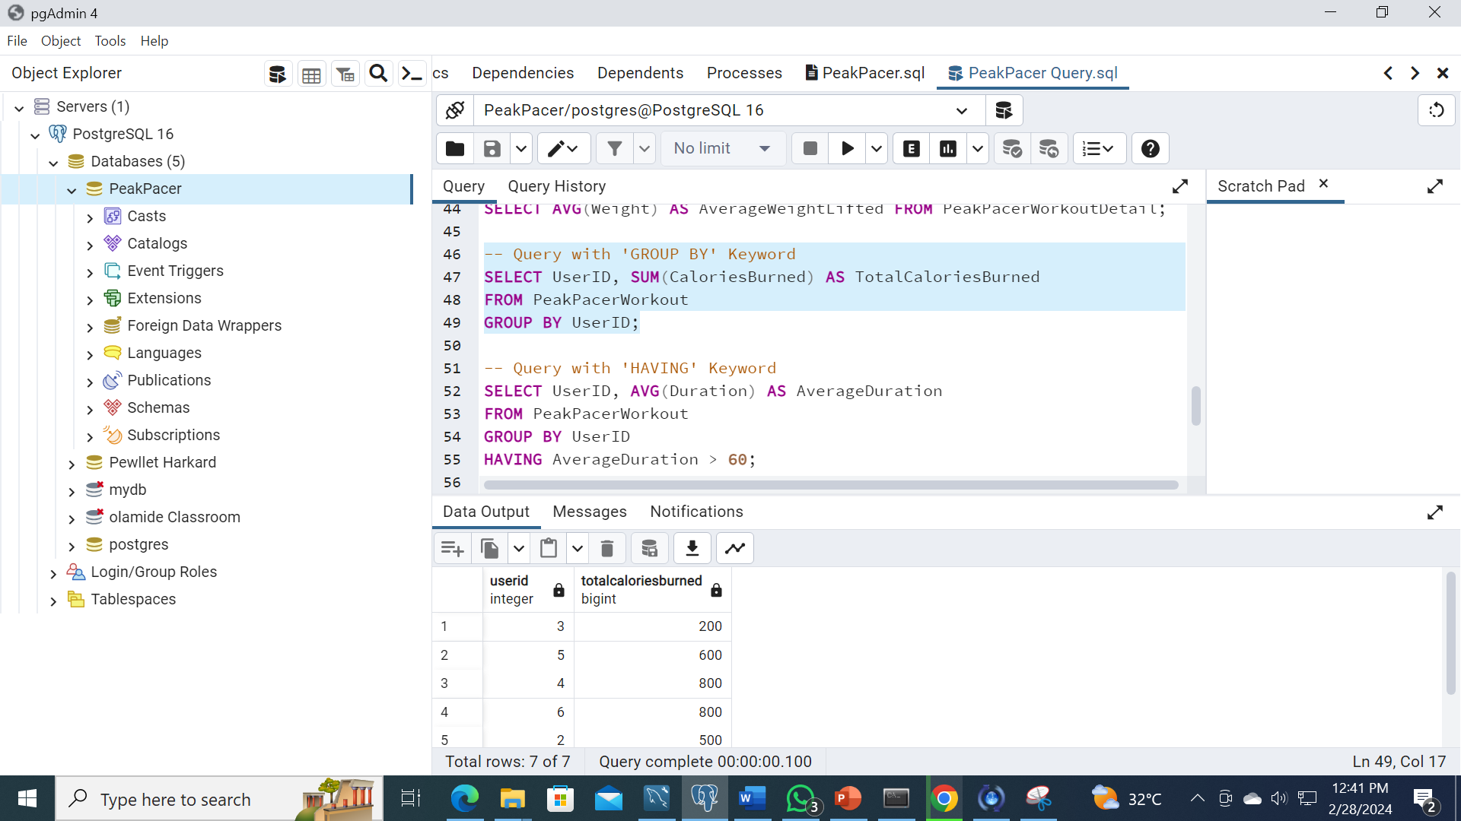
Query with ‘GROUP BY’ Keyword (pgAdmin 4)
Notes:
Photo by bruce mars on Unsplash

Slide 13
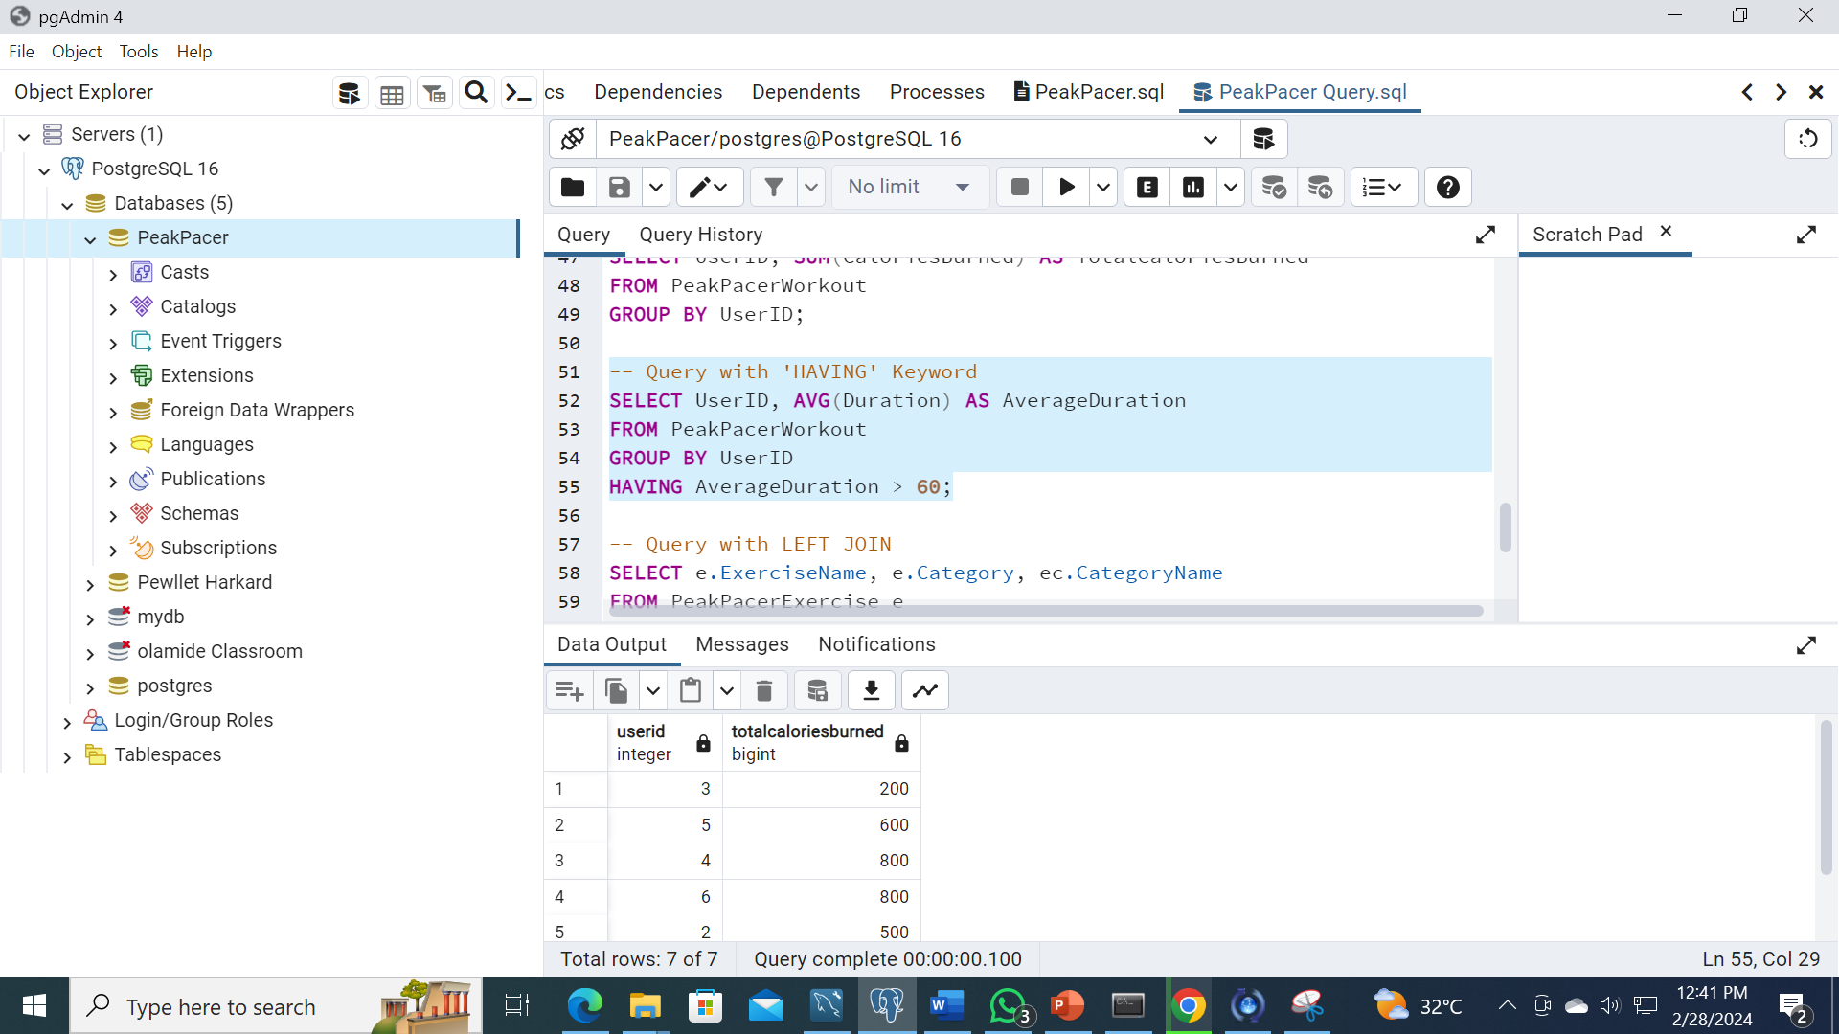
Query with ‘HAVING’ Keyword (pgAdmin 4)
Notes:
Photo by bruce mars on Unsplash

Slide 14
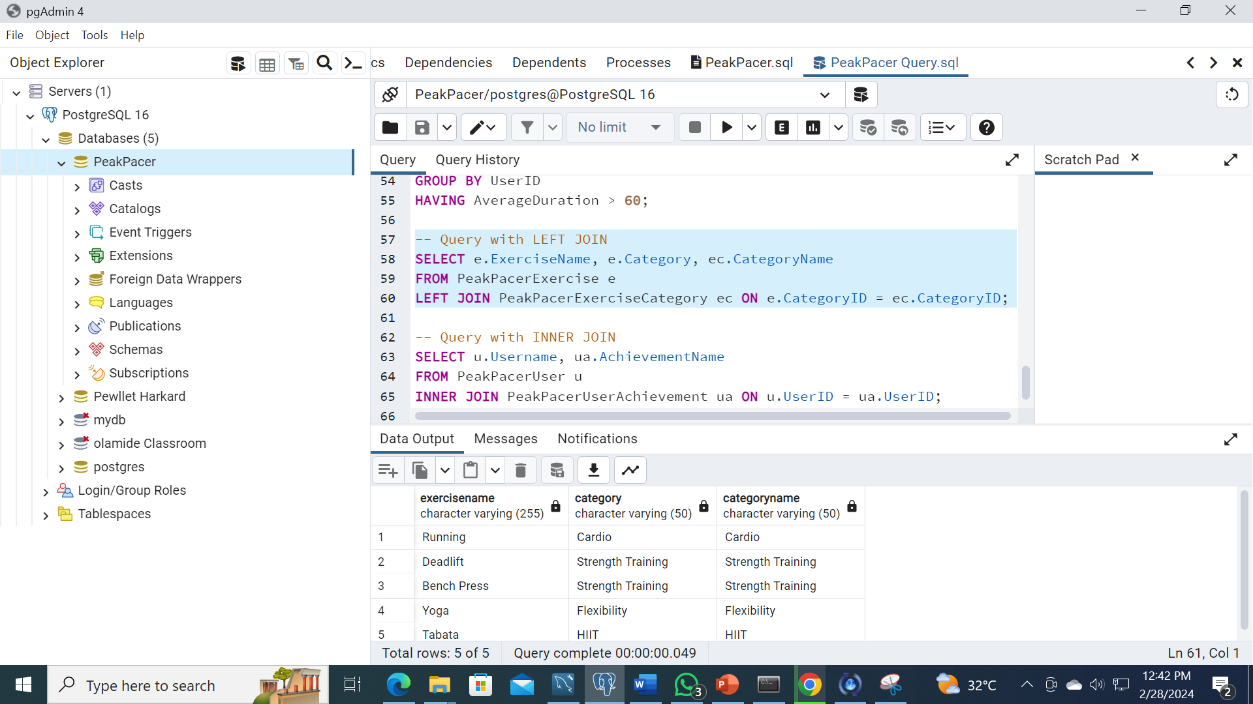
Query with LEFT JOIN (pgAdmin 4)
Notes:
Photo by bruce mars on Unsplash

Slide 15
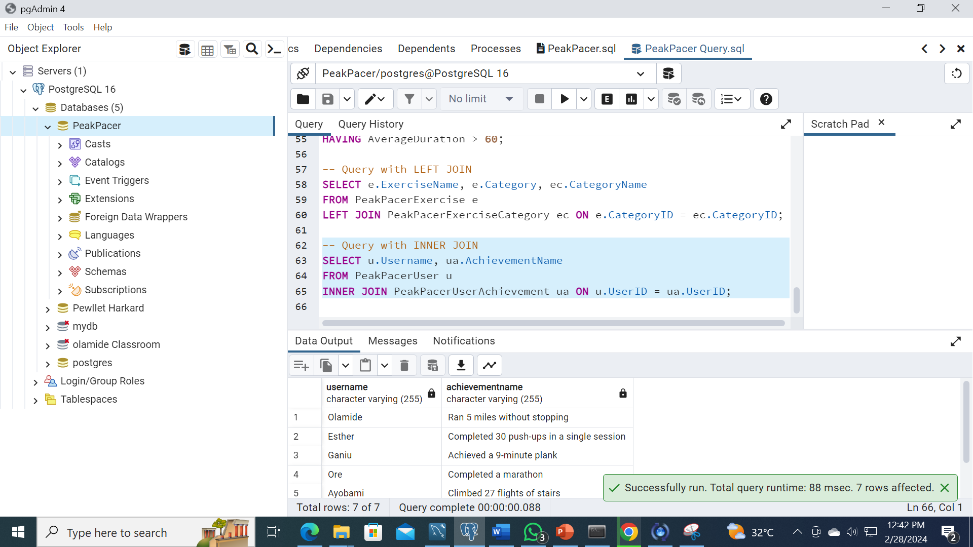
Query with INNER JOIN (pgAdmin 4)
Notes:
Photo by bruce mars on Unsplash

Slide 16
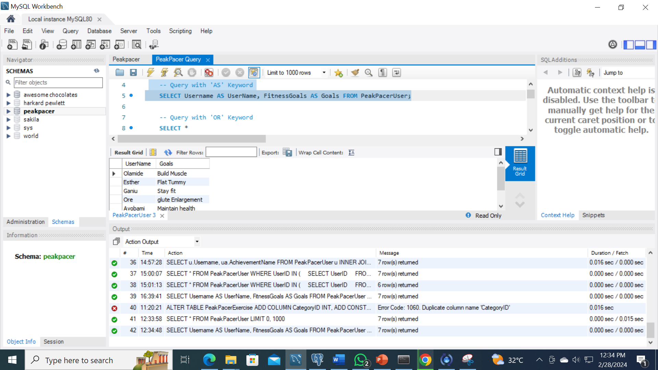
Query with ‘AS’ Keyword (MYSQL)
Notes:
Photo by bruce mars on Unsplash

Slide 17
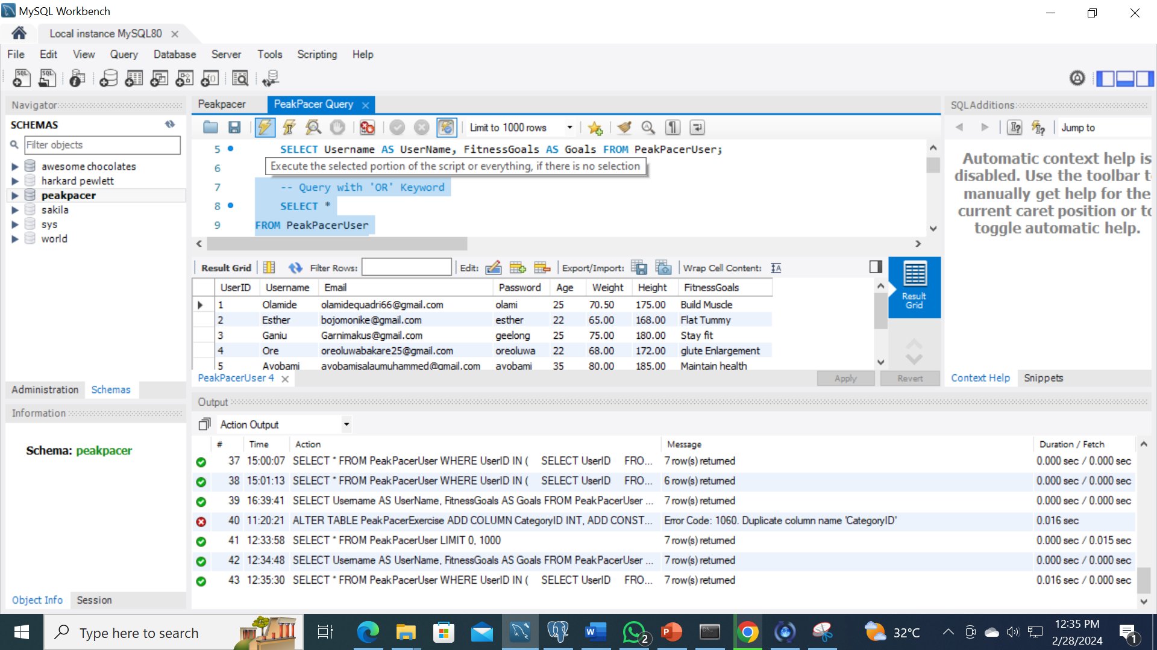
Query with ‘OR’ Keyword (MYSQL)
Notes:
Photo by bruce mars on Unsplash

Slide 18
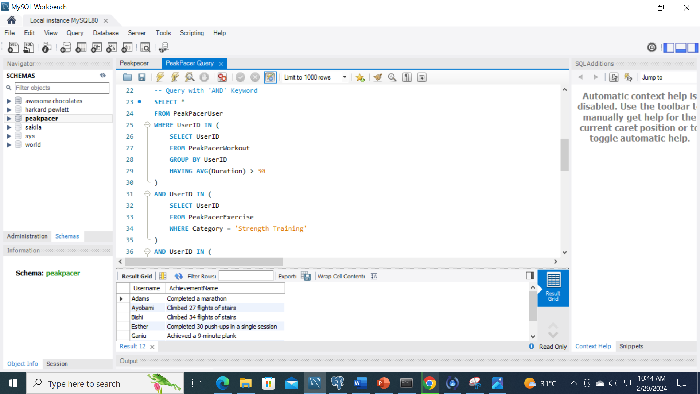
Query with ‘AND’ Keyword (MYSQL)
Notes:
Photo by bruce mars on Unsplash

Slide 19
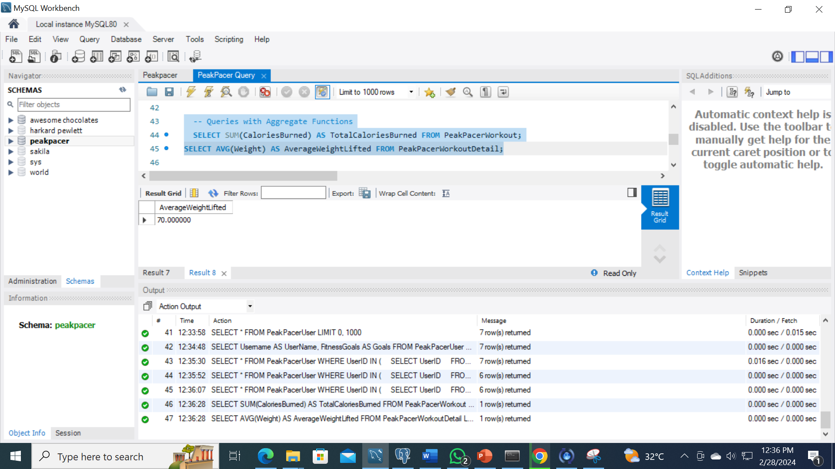
Query with Aggregate Function (MYSQL)
Notes:
Photo by bruce mars on Unsplash

Slide 20

Query with ‘GROUP BY’ Keyword (MYSQL)
Notes:
Photo by bruce mars on Unsplash

Slide 21
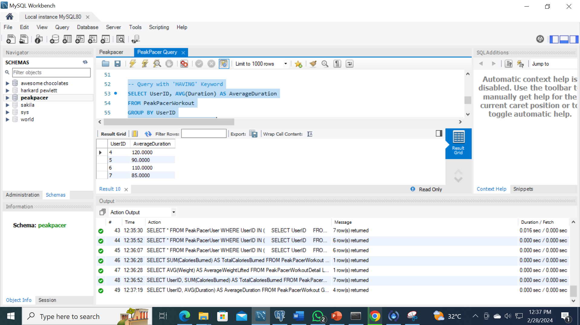
Query with ‘HAVING’ Keyword (MYSQL)
Notes:
Photo by bruce mars on Unsplash

Slide 22
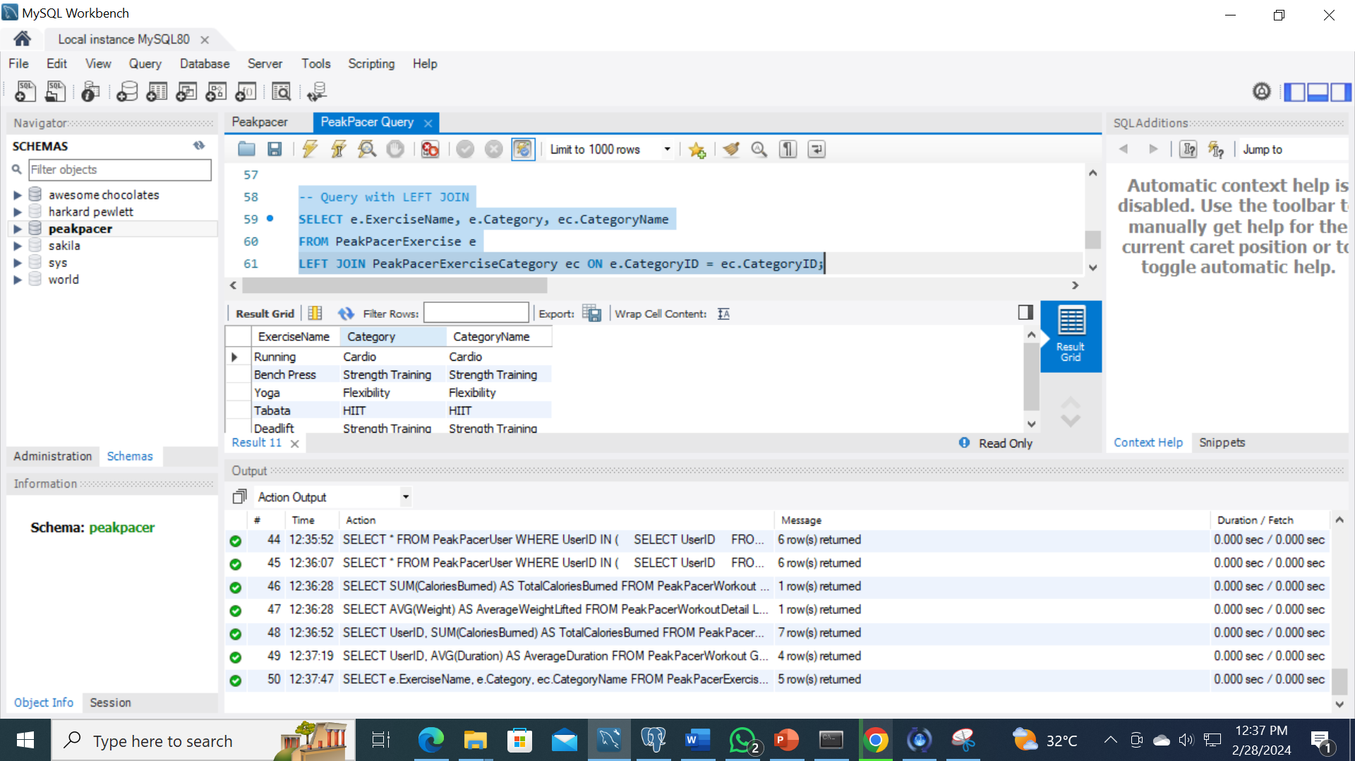
Query with LEFT JOIN (MYSQL)
Notes:
Photo by bruce mars on Unsplash

Slide 23
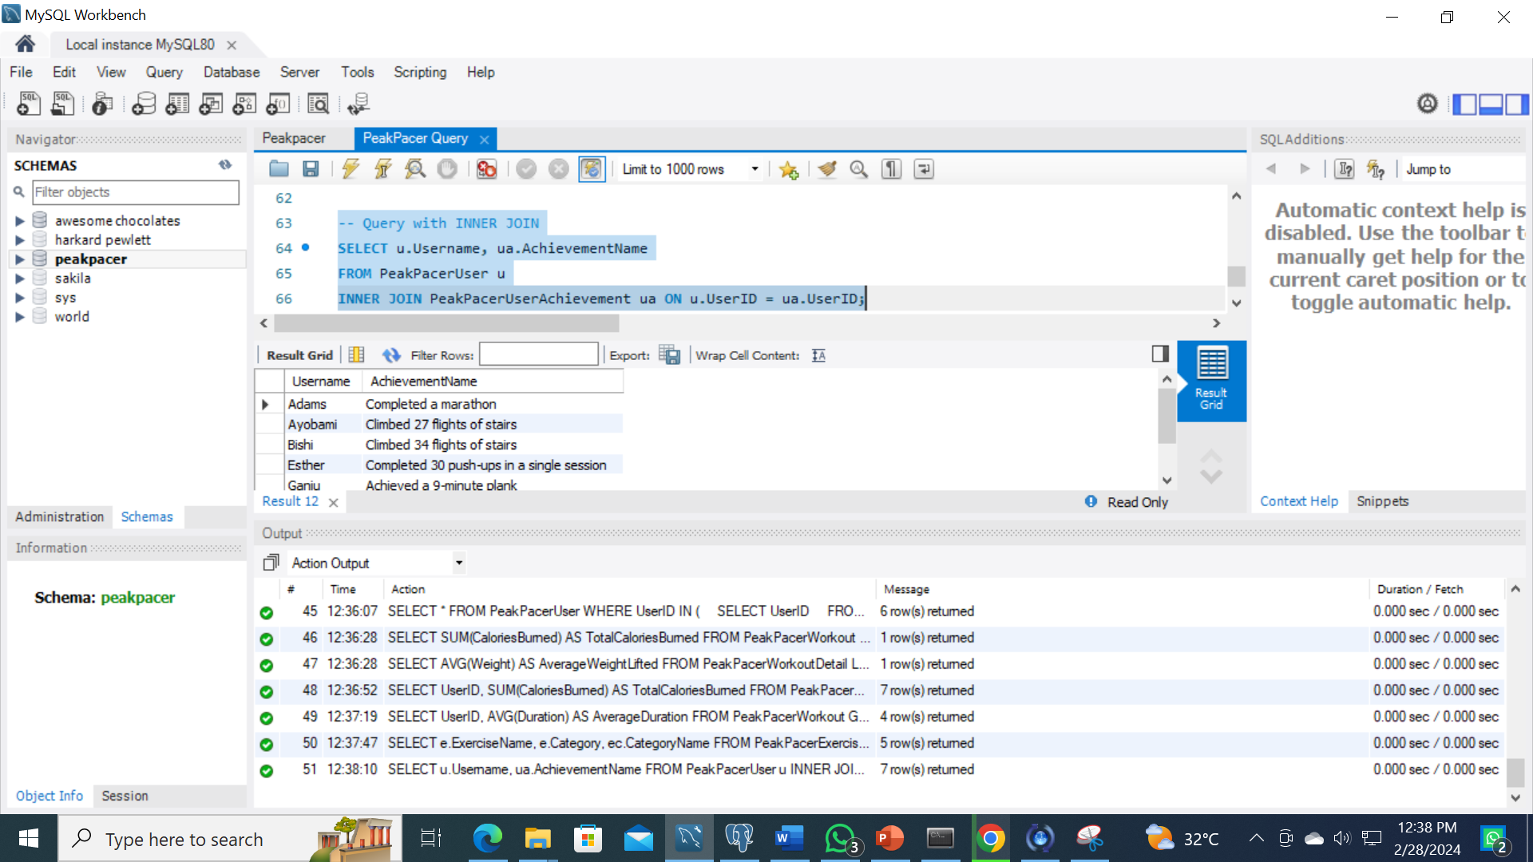
Query with INNER JOIN (MYSQL)
Notes:
Photo by bruce mars on Unsplash

Slide 24



THANK
YOU

